Slide 1
Resume Classification in NLP
Sarika Bahir
Pichika Viswanadh Karthik
Sanjana Pal
Rakesh NV
Chittimada Jayaram
Kishan Gowda
Mallikarjun BE

Slide 2
Contents
Project Description
Import Libraries
Data Preprocessing
Exploratory Data Analysis
Model Building
Model Evaluation
Deployment

Slide 3
Project Description
Resume classification, a valuable tool used in real-life scenarios to simplify and streamline the hiring process, has become essential for busy hiring managers and human resources professionals. By automating the initial screening of resumes using SpaCy‘s magic , a resume classifier acts as a smart assistant, leveraging advanced algorithms and natural language processing techniques to extract key details such as contact information, education history, work experience, and skills.
This structured data allows recruiters to efficiently evaluate candidates, search for specific qualifications, and integrate the parsing technology with applicant tracking systems or recruitment software. By saving time, reducing errors, and facilitating informed decision-making, resume parsing technology revolutionizes the resume screening process and enhances the overall recruitment experience.

Slide 4




Slide 5
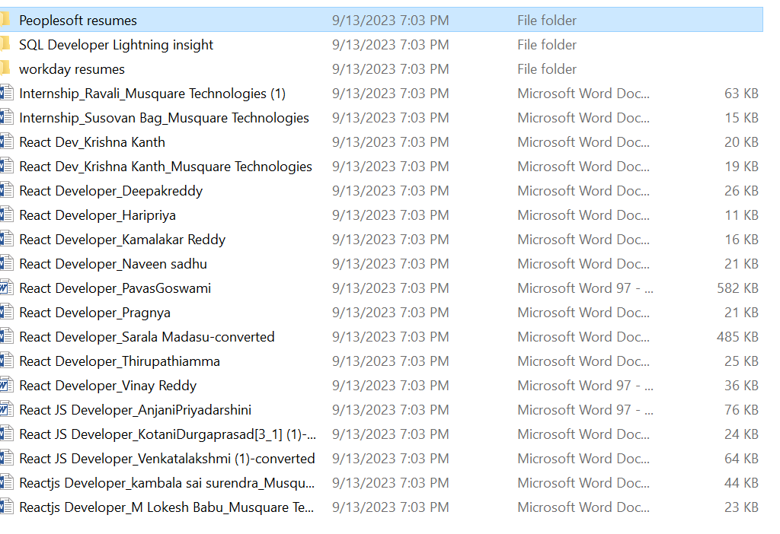
Dataset

Slide 6
Used Libraries
Pandas
Matplotlib
Spacy
NLTK
Pandas
Scikit-learn
Zipfile
Os
Textract
RE (regular expression)
Word_tokenize
Stopword
CountVectorizer
wordcloud
DecisionTreeClassifier
Confusion_matrix

Slide 7
Exploratory Data Analysis
Import word_tokenize
Extract url from details and add to df
Find phone number and remove it
Remove url and word containing https
Remove empty resumes
Remove duplicate resumes
Use text strip(clean data into pure form)
Remove emoji and image
Remove boilerplate text
Remove stopword
Tokenization
Lemmatization
N-grams
Word cloud

Slide 8
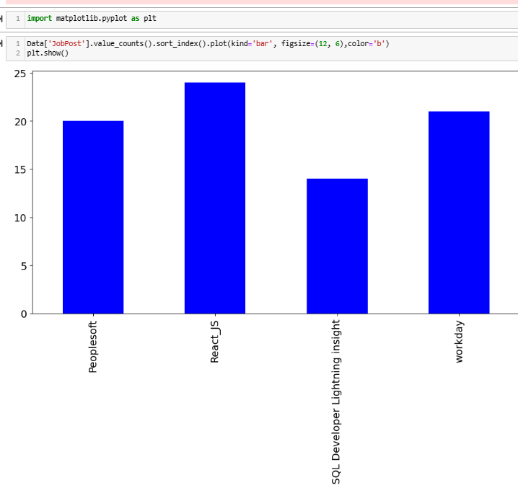
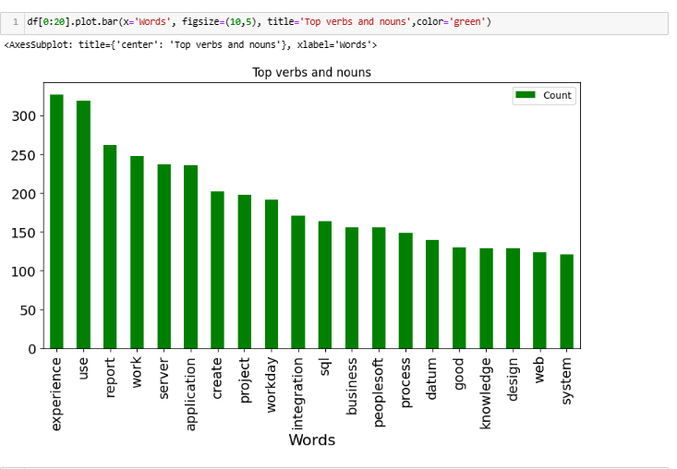
Data Visualization
Jobpost count
Word count in N-grams(top words and nouns

Slide 9
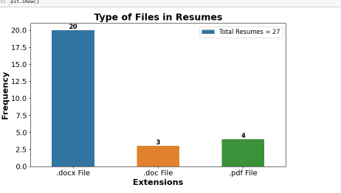
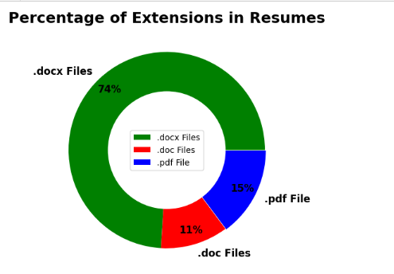
Wordcloud
Matplotlib and pylab
Types of files in resumes
Percentage of extensions in resumes

Slide 10
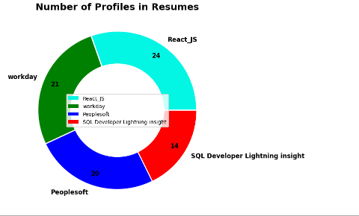
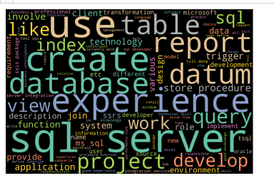
Number of profile in resumes
Most occurring words
jobpost==sql developer
Wordcloud
SQL = Data[Data['JobPost'] == 'SQL Developer Lightning insight'] # Filter rows where JobPost is 'React_JS'

Slide 11
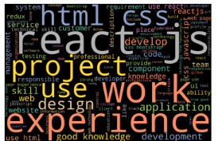
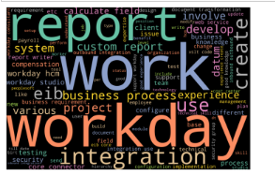
jobpost==React_js
Jobpost==workday
jobpost

Slide 12
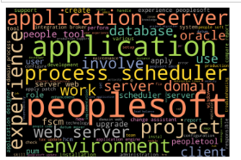
jobpost==peoplesoft

Slide 13
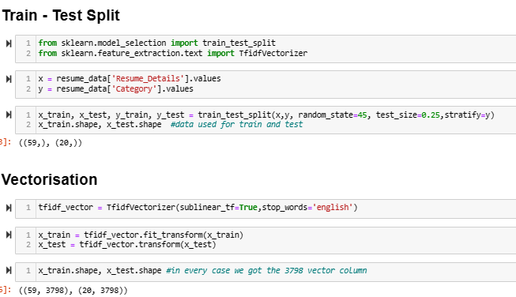
Train Test
Vectorisation

Slide 14
Model Building
Random Forest
SVM
Logistic Regression
Bagging Classifier
Gradient Boosting Classifier
AdaBoost Classifier
Naive Bayes

Slide 15
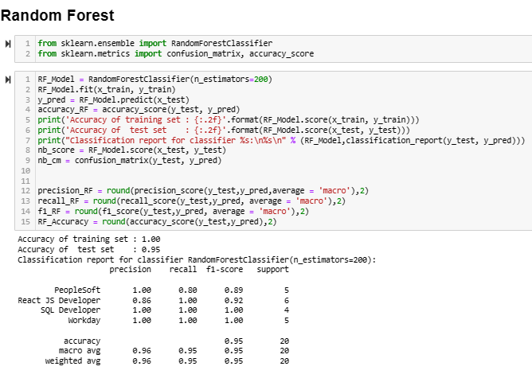
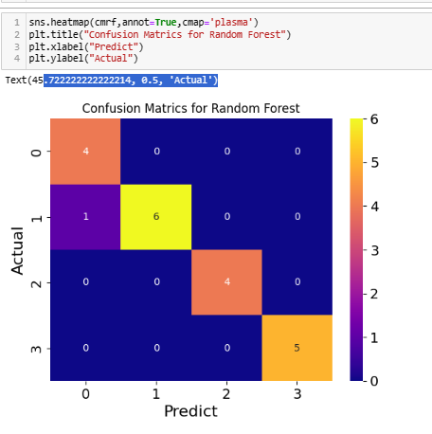
Random Forest
Confusion Matrix

Slide 16
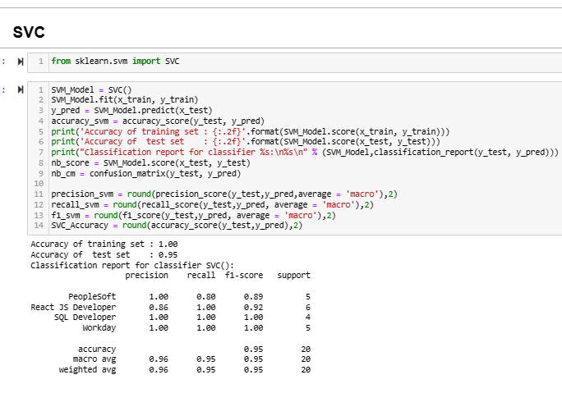
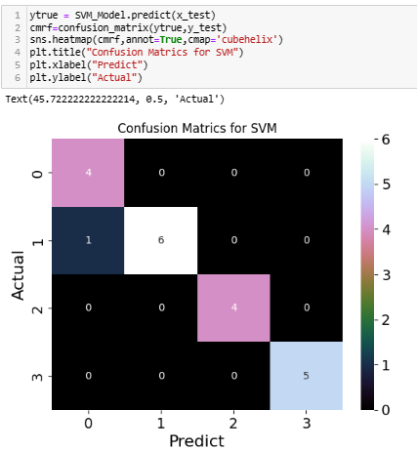
SVM

Slide 17
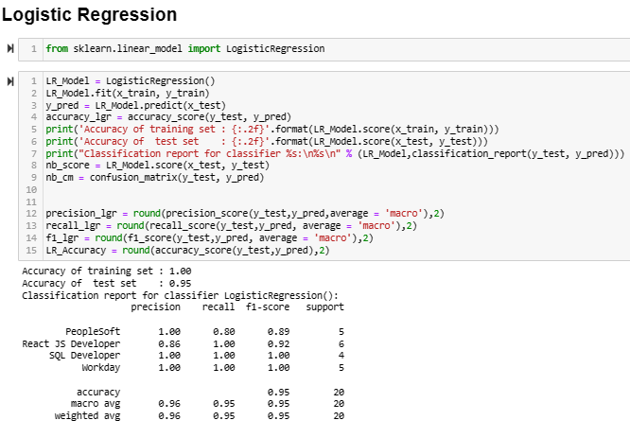
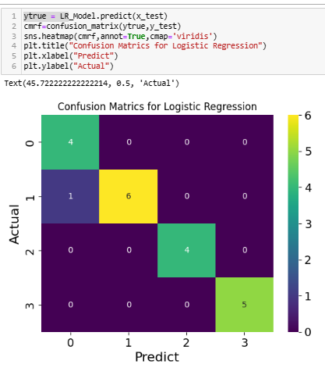
Logistic Regression

Slide 18
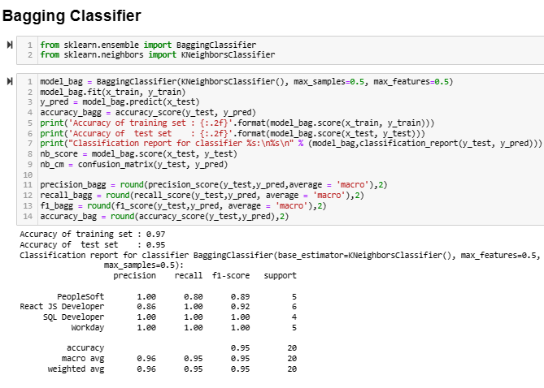
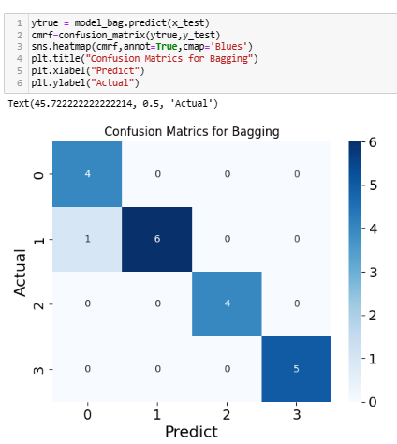
Bagging Classifier

Slide 19
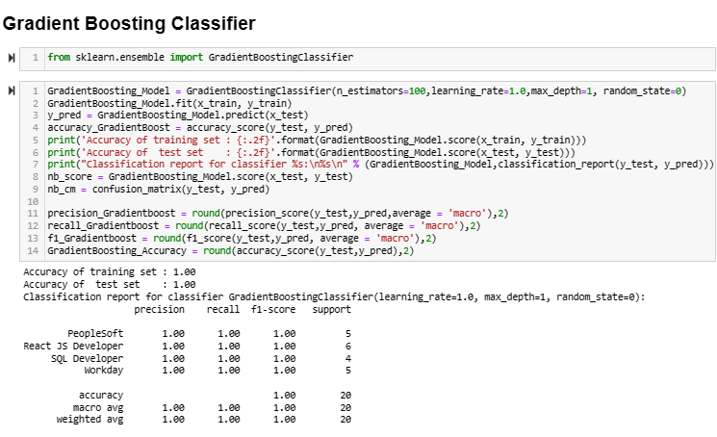
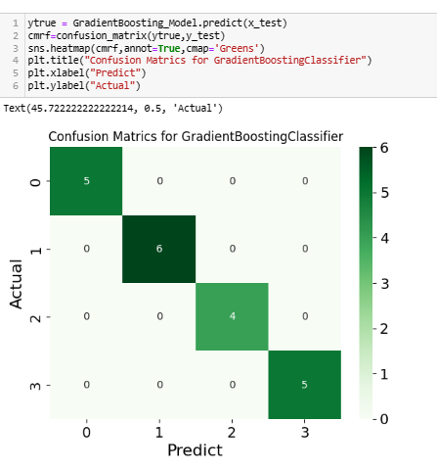
Gradient Boosting Classifier

Slide 20
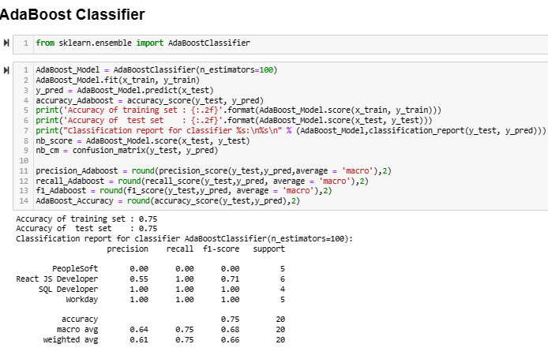
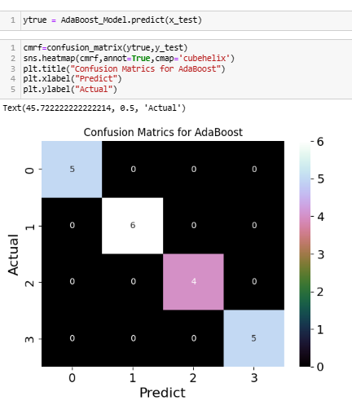
AdaBoost Classifier

Slide 21
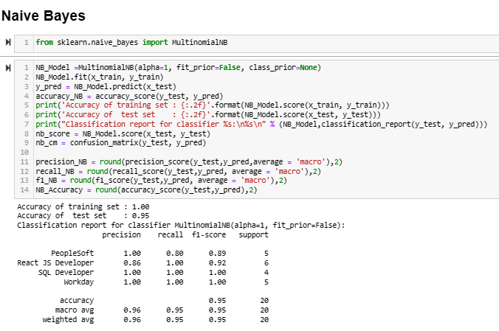
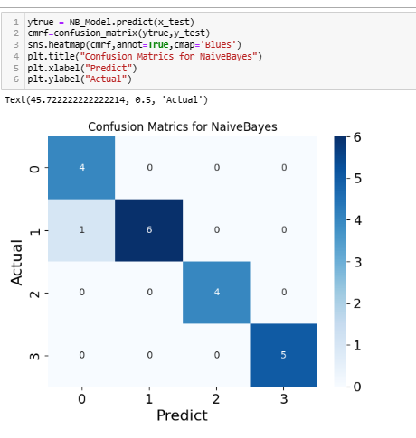
Naive Bayes

Slide 22
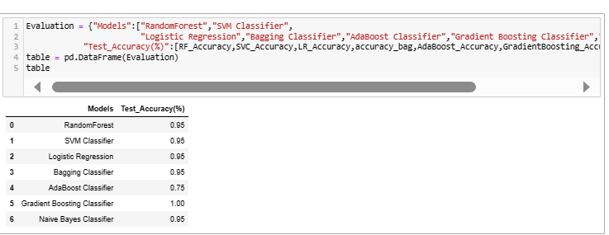
Model Evaluation

Slide 23
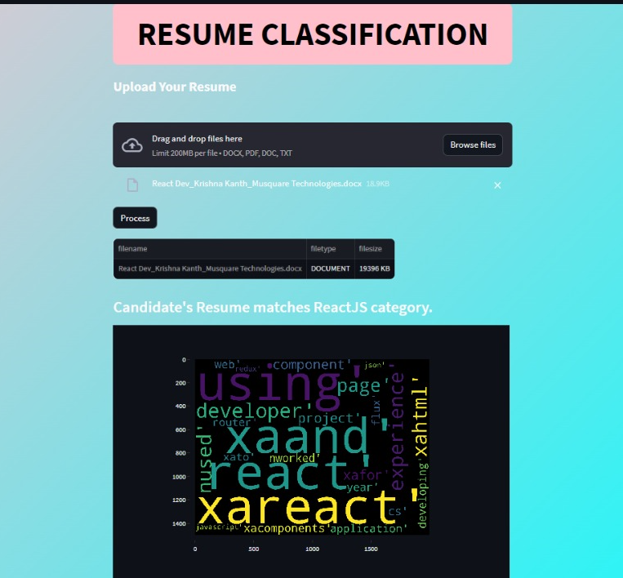
Model Deployment

Slide 24
Thank you

